Slide 1
THE MIDDLE EAST

Slide 2
The Turkish Empire (Ottomans)
History of conflict. Recall the Crusades
Important for oil, transportation, and spiritual reasons

Slide 3
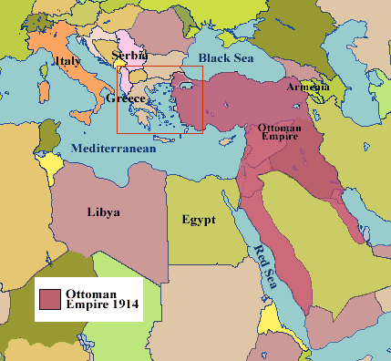

Slide 4
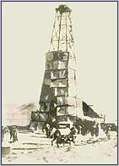
Oil Becomes the New International “Coin of the Realm!”
American oil companies [Texaco & Chevron], gain oil concessions in Bahrain in 1929.
In 1933, American oil companies win an oil concession in Saudi Arabia.
ARAMCO [Arab-American Oil Co,] is created in 1939.

Slide 5
MANDATE SYSTEM
Designed to be a solution to what to do with the defeated colonies.
Two opposing views: 1. disguise for colonial annexation 2. “sense of responsibility towards backward peoples.
League set up a Mandate Commission to supervise work of Mandated Powers
Their job was to help their territories towards self-government.
League’s commission had no power over the “Powers”.

Slide 6
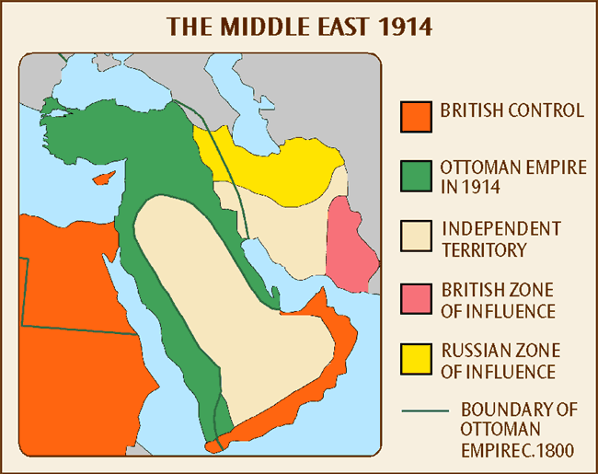

Slide 7
BRITAIN, ARAB NATIONALISM, AND WWI
1914 Turkey planned to attack Egypt, hoped for support from other Muslim nations.
Britain rushed in colonial troops—they won—gained control of the Suez Canal
1916 Brits. attacked Palestine
They gained Gaza, Askalon, Jaffa, and entered Jerusalem
Brits. Called back to France
Faisal (Iraq King) supported the British
Support won by T.E. Lawrence (Welsh) (Lawrence of Arabia) (Arab Revolt against Ottomans) and a vague promise of support for independent Arab states.
Palestine became a British Mandate after 1923

Slide 8
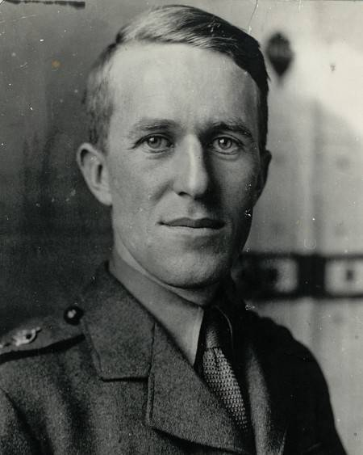
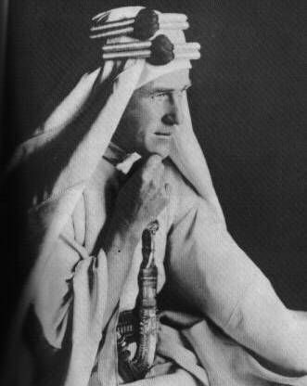
T. E. Lawrence [1888-1935]
“Lawrence of Arabia,” The Legend Begins

Slide 9
MESOPOTAMIA (During and after WWI)
Defense responsibility of Indian Government
Brits. Captured delta above the Persian Gulf in 1914 (Shatt al-Arab)
Turks suffered other defeats
Eventually Brits given Mesopotamia as a mandate
Serious revolts
Brits put them down and then created the kingdom of Iraq under Faisal
1932 Iraq admitted to the League of Nations
(Iran info. in Falk)

Slide 10
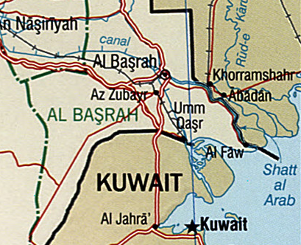

Slide 11
PALESTINE AND ARAB HOPES
1st Arab chief to revolt against Turks—Hussein, the ruler of Hejaz (coastal strip running down the eastern bank of the Red Sea
Hoped for support from Brits. McMahon, The British representative in Cairo, gave support with vague agreement of Arab independence (1915)
Hussein’s son Faisal went to Versailles in 1919 to get the promised land. France offered united crown of Syria and Lebanon, but once he accepted they drove him out.
Brits. Cut out a part of Palestine to give to Abdullah’s, Faisal’s brother (Trans-Jordan)

Slide 12
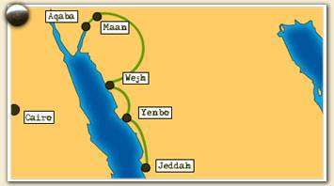
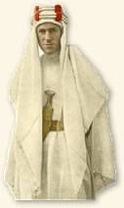
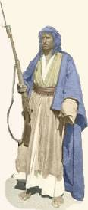
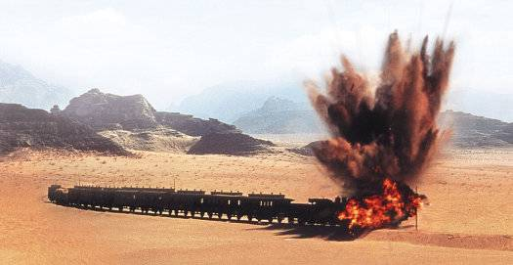
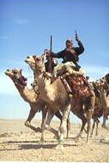
The Arab Revolt: 1916-1918

Slide 13
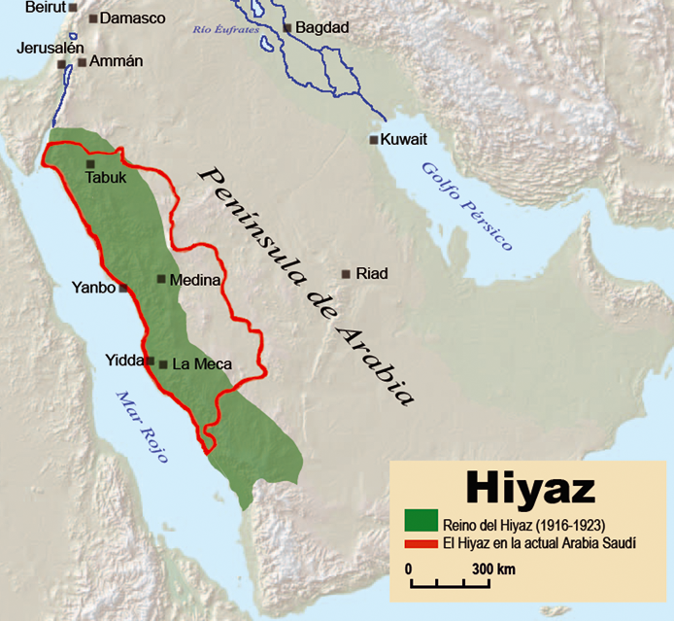

Slide 14
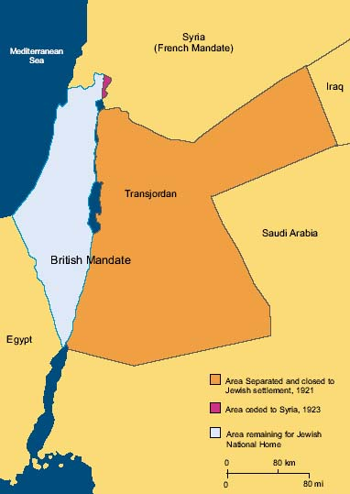

Slide 15
PALESTINE POLITICS
By 1914 Jews were migrating to Palestine (Zionist Movement founded by Theodore Herzl—the right to live in Palestine)
Movement a lot of American Support.
1917 British Foreign Secretary, A.J. Balfour, wrote the ‘Balfour Declaration’—promise to create a Jewish homeland in Palestine. Why was it important to Canada?
Policy upset everyone—limited Jewish immigration and Palestinians resented influx of Jews.
McMahon promised everything to the Arabs and Balfour promised Palestine to the Jews. Seeds for future conflict.

Slide 16
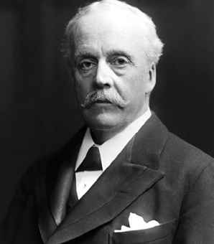
British Promise to the Jews: Balfour Declaration, 1917
His Majesty’s Government views with favor the establishment in Palestine of a national home for the Jewish people and will use their best endeavors to facilitate the achievement of this object, it being clearly understood that nothing shall be done which may prejudice the civil and religious rights of existing non-Jewish communities in Palestine…
Sir Arthur James Balfour Br. Foreign Secretary

Slide 17
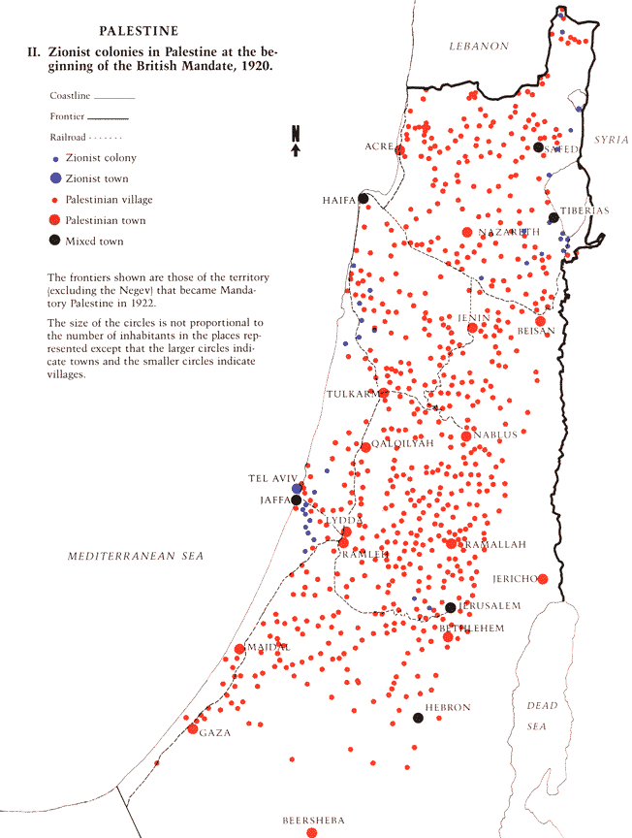
Jews & Arabs in Palestine, 1920
In 1920, there was 1 Jew to every 10 Arabs in Palestine.
By 1947, the ratio was 2 Arabs for every Jew.
The Arabs felt that they were losing control of their “country!”

Slide 18
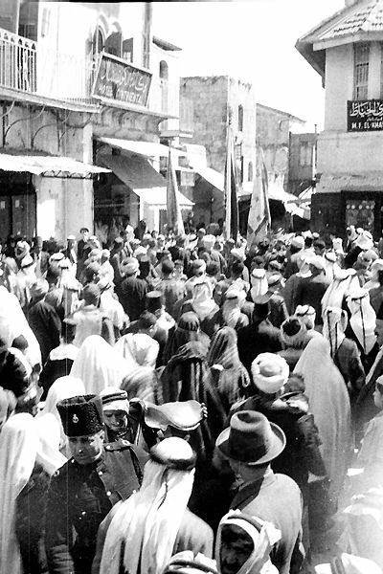
British White Paper of 1939
Limited Jewish immigration to Palestine to 75,000 over the next five years.
It ended Jewish land purchases.
Independence for Palestine within 10 years.
It is NOT British policy that Palestine become a Jewish state.

Slide 19
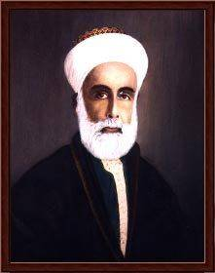
Hussein-McMahon Letters, 1915
....Britain is prepared to recognize and uphold the independence of the Arabs in all regions lying within the frontiers proposed by the Sharif of Mecca....
Hussein ibn Ali, Sharif of Mecca

Slide 20
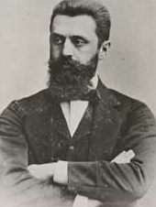
Theodore Herzl 1860-1904

Slide 21
“New” Countries & Ruling Families Emerge!
Prince Faisal → “ruler” of Trans-Jordan.
Prince Abdullah → “ruler” of a newly-created Iraq [pasted together from three distinct geographic regions].
The House of Saud → put on the throne of the newly-created Saudi Arabia.
The Pahlavi Family → put on the throne of a new Iran.
Mustafa Kemal → leads a military/nationalist movement in Turkey.

Slide 22
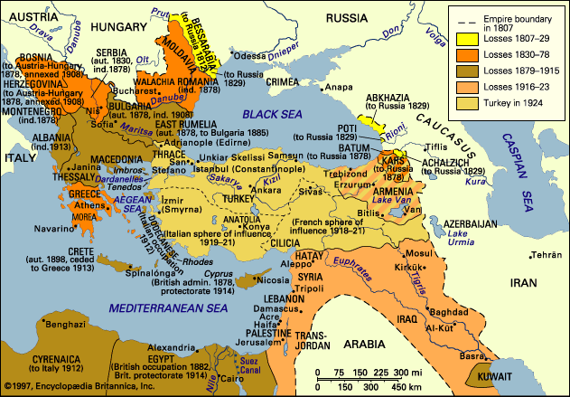
Treaty of Lausanne, 1923
Modern Turkey Is Born.

Slide 23
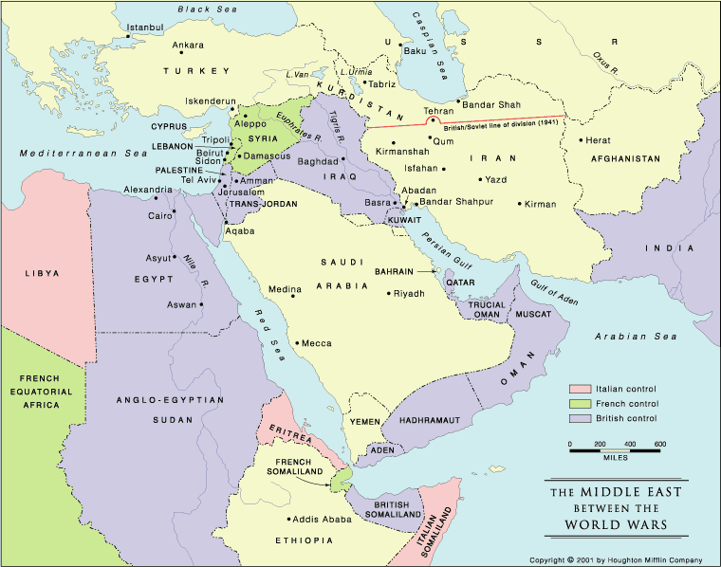

Slide 24
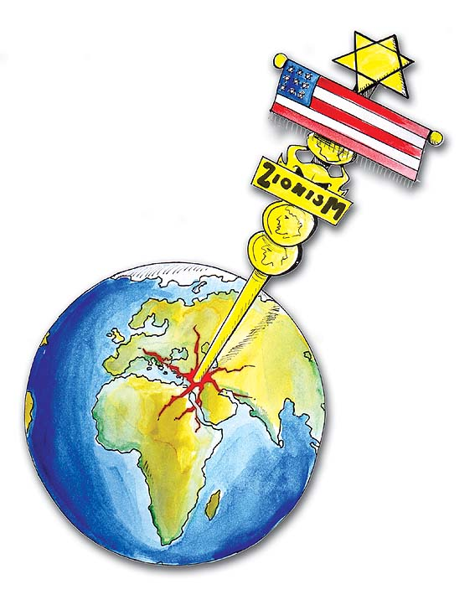

Slide 25
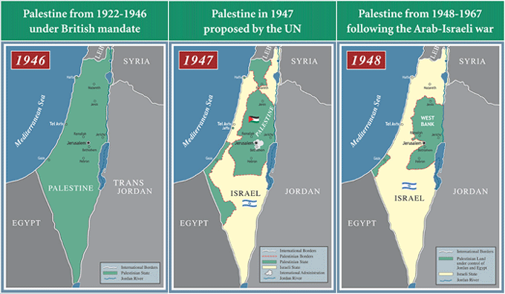

Slide 26
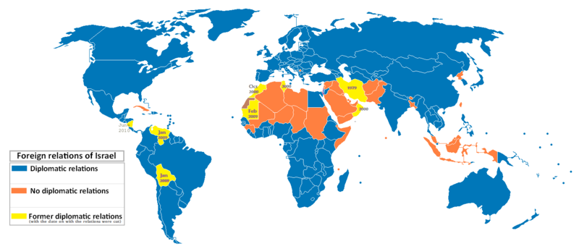

Slide 27
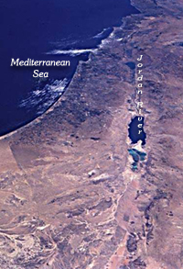
Economic Comparative Analysis
In the land between the Mediterranean sea and the Jordan river…
Israel
Unemployment 1 out of 10
Growth rate -0.8%
Palestine
Unemployment 1 out of 2
Growth rate -18%
GDP
Per Capita
Annual Budget
UN HDI Rank
$117.4 Billion
$19,500
$45.1 Billion
22 out of 177
GDP
Per Capita
Annual Budget
UN HDI Rank
$2.4 Billion
$700
$1.2 Billion
102 out of 177
A Palestinian has to work for 28 years to earn what an Israeli does in one year
Sources: United Nations 2004 Human Development Index (HDI), 2003 CIA World Fact Book.

