Slide 1
1930s
International
By: Dany and Matt

Slide 2
The 1920s and 1930s, Humanities Darkest Hour.
The Great Depression
Two decades of mass poverty, violent extremism and world wars.
The great depression.
Civil war, corruption and the rise of fascism.

Slide 3
Germany
-Hitler pinned the blame of losing the war on Jewish people.
-The great depression led to vulnerable citizens looking for a hope to Germany's crisis.
-Hitler was appointed to Chancellor in 1933.
-The parliament fire is where Nazis gained majority government power.
-Hitler AKA Fuhrer gained full power in 1934 after the death of president Von Hindenburg.
- Kristallnacht was a series of events involving vandalism of Jewish homes, schools, and business resulting in many Jewish casualties.
Hitler giving one of his highly persuasive speeches in front of a large crowd.

Slide 4
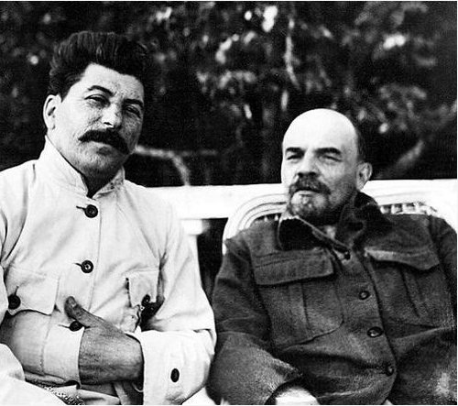
The Soviet Union
After the civil war, Vladimir Lenin is victorious and is now the new leader of Russia.
The Soviet Union is created by uniting Russia, Ukraine, Belarus, and Transcaucasus.
After the death of Vladimir Lenin, a power struggle starts between the party. Joseph Stalin emerges as the new party leader. His rival Leon Trotsky is exiled and then murdered in 1940.
Beginning of Stalin's purge over the Soviet Union.
Soviet state development.
The state sets goals named the five year plans.
The great purge.
Stalin's death and the start of the world war.
Joseph Stalin and Vladimir Lenin

Slide 5
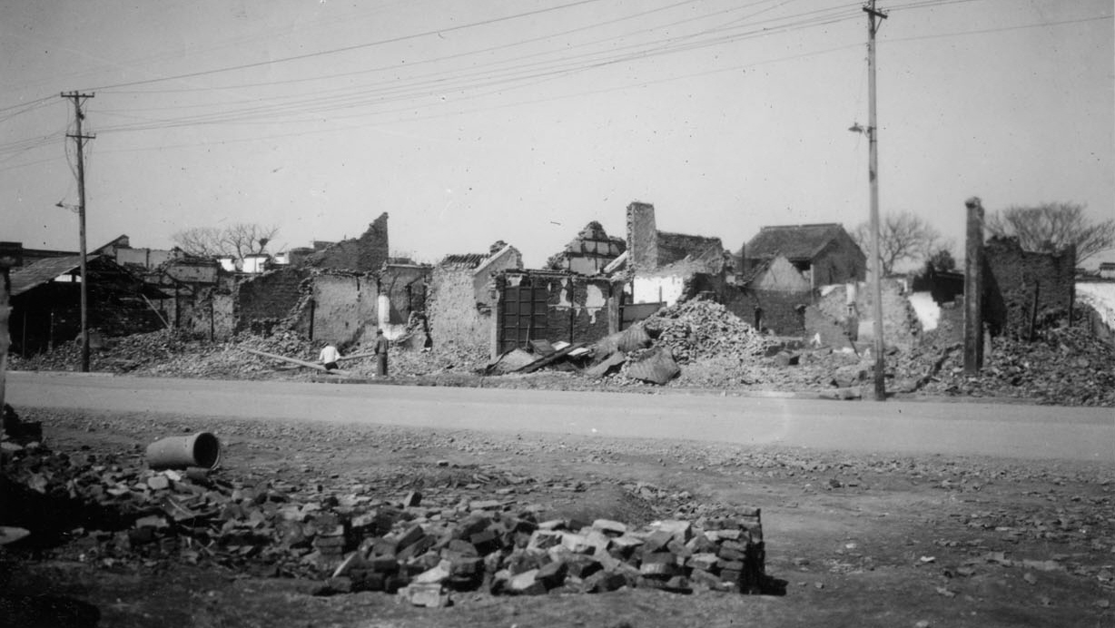
Japan
-The invasion of Manchuria installed a Puppet Regime.
-Anti-Comintern included Nazi Germany, Japan, and Italy and was directed against Communism.
-The Second Sino Japanese in resulted the violent capture of Beijing, Shanghai, and Nanjing.
The devastating infrastructure aftermath of the “Rape of Nanjing”

Slide 6
France
French strikes
Raymond Poincare
France lost over 1.5 million men and had 3.5 million wounded during the world war.
France suffers from a damaged economy.
Raymond Poincare serves as prime minister from 1922 to 1924.
The French chamber of deputies full payment from germany.
Raymond Poincare resigns from political life, throws france into disarray.
radical leftist Popular Front emerged victorious.
France declares war on germany.

Slide 7
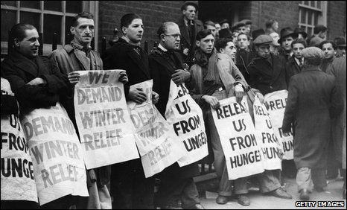
Britain
-Great Depression happens in 1929 and is caused by US stock market crashing resulting in mass unemployment.
- Gandhi visits London to attend the Second Round Table Conference to decide the future status of India.
-The Stresa Conference occured on April 1935 with Germany, Britain, and France discussing how to oppose Adolf Hitler's plans to rearm Germany.
Men rallying for jobs to try to provide for their families

Slide 8
Bibliography
Germany
-https://www.youtube.com/watch?v=jFICRFKtAc4&t=162s
-https://www.historyonthenet.com/nazi-germany-timeline
https://www.history.com/topics/world-war-ii/nazi-party
Japan
-https://www.britannica.com/event/Second-Sino-Japanese-War
-https://www.lermuseum.org/interwar-years-1919-1938/japanese-invasion-of-manchuria-1931
Britain http://www.bl.uk/learning/timeline/item124207.html
-http://www.bl.uk/learning/timeline/item107595.html
Russia
http://soviethistory.msu.edu/1936-2/the-great-terror/
https://russiapedia.rt.com/of-russian-origin/stalins-purges/
France
http://www.fsmitha.com/h2/ch12-france.htm
https://en.wikipedia.org/wiki/Great_Depression_in_France

